Slide 1


Il Dipartimento di Elettronica, Informazione e Bioingegneria
2024
End-coupled filter : design and simulation
Milano, 2024

Slide 2
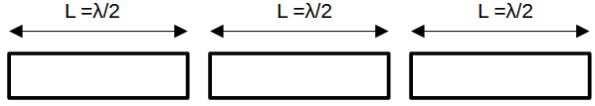
END-COUPLED FILTER: theoretical introduction
The “end-coupled filter” is a spefic topology for band-pass filters, employed for microwave filtering applications.
Aside it is shown its generic scheme, where identical segments of conducting material are placed adjacent, on the same line, one after the other, such that they are separeted by empty gaps only.
The functioning principle see the lines behaving like resonators, while the gaps are the inverters.
In this “report”, we will address 4 different levels of design:
Chebishev Low-pass prototype
Ideal filter with lumped elements
Ideal transmission lines implemantation
Employment of μ-strip substrate and electromagnetic simulation

Slide 3
END-COUPLED FILTER: technical specifications
Parameters | Required values
Dielectric Substrate | ε = 3.2
Dielectric thickness | 1.2 mm
Metal thickness | 5 μm
Passband | 4.1 – 4.8 GHz
Return Loss | 18 dB
Attenuation 1 | 40 db at 3 GHz
Attenuation 2 | 35 dB at 5.5 GHz

Slide 4
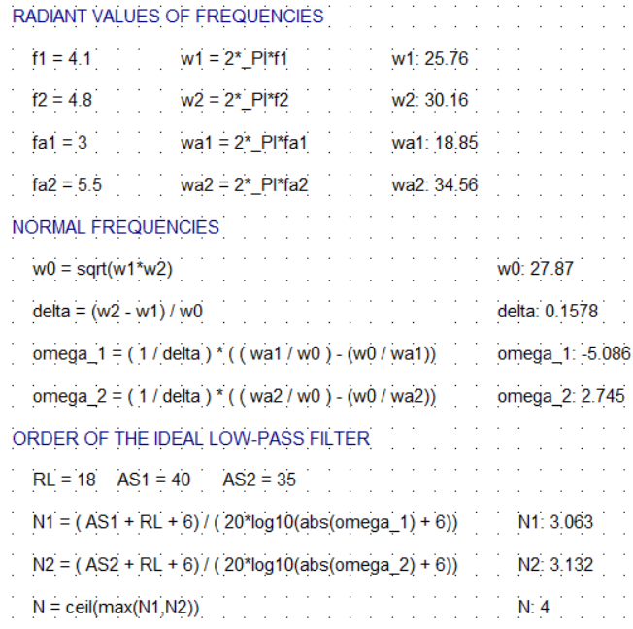
Low pass prototype: order of the filter
In particolar, we call “w0” (that stands for omega zero) the central angular frequency, while “delta” is the so-called relative bandwidth.
The order of the filter refers to the number of “fluctuations” in the filter response (in terms of reflection) inside the band.
Moreover, N is linked to the out-of-band attenuation. Indeed, the slope with which the transmission (or the reflection) plot enter (goes out) the band is directly proportional to N.
In the realisation of the filter, N tells the number of resonators and N+1 is the amount of inverters theoretically sufficient to obtain the desidered plot.

Slide 5
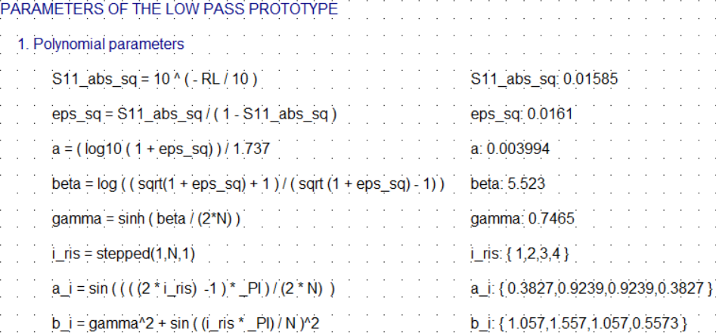
Low pass prototype: polynomial parameters (Chebishev model)

Slide 6
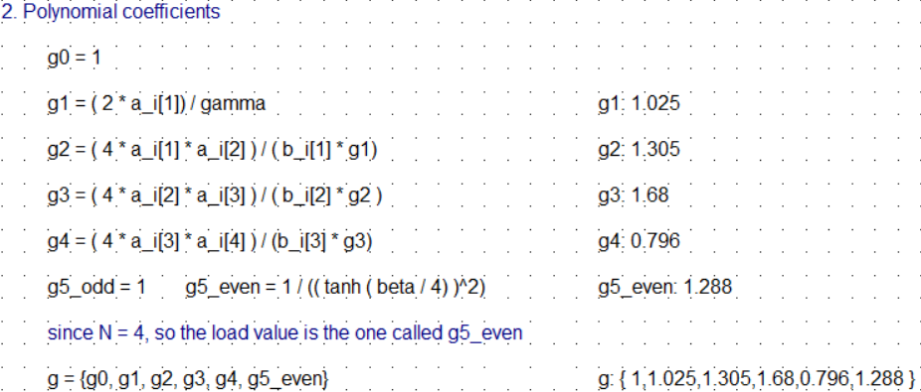
Low pass prototype: polynomial parameters (Chebishev model)

Slide 7
From Low-pass to ideal band-pass filter, with lumped elements
THEORY
With the parameters calculated so far, the low-pass prototype could be drawn and simulated on AWR. However, since this project aims to desingn a band-pass filter, the next passage will be directly the evaluation of the parameters to obtain an all-shunt ideal band-pass filter.
Indeed, according to the specific frequency transformation from low-pass to band-pass, we will realize the filter with a LC circuit in the band-pass model.
From a practical point of view, a LC shunt-type resonator it is realized according to the formula which describe the open-circuited half-lambda resonator;
$B_{eq}=\frac{π}{2∗Z_{c}}$
$C_{eq}=\frac{B_{eq}}{ω_{0}}$
$L_{eq}=\frac{1}{ω^{2}∗C_{eq}}$

Slide 8
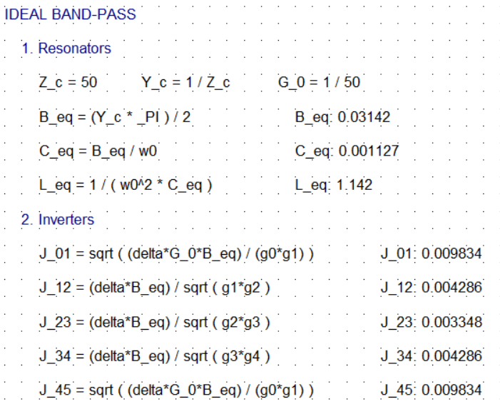
From Low-pass to ideal band-pass filter, with lumped elements
THEORY
As for the inverters, their values depend on the value of C_eq. Do recall that the all-shunt prototype is derived from the low-pass ideal prototype where C_eq = 1, and for which:
In order to obtain the inverters values for a different capacitance, t’s sufficient to multiply the inverters values by
$J_{0,1}=J_{N,N+1}=\sqrt{\frac{ω∗Δ}{g_{N}∗g_{N+1}}}$
$J_{i,i+1}=\frac{ω_{0}∗Δ}{\sqrt{g_{i}∗g_{i+1}}}$
$\sqrt{C_{eq}}$

Slide 9
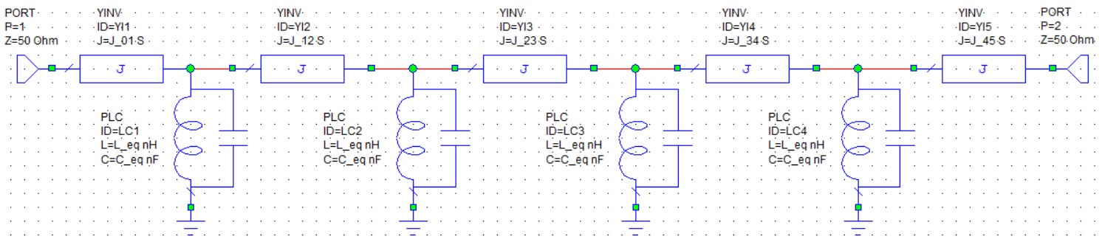
STEP 1: From Low-pass to ideal band-pass filter, with lumped elements
SCHEMATIC

Slide 10
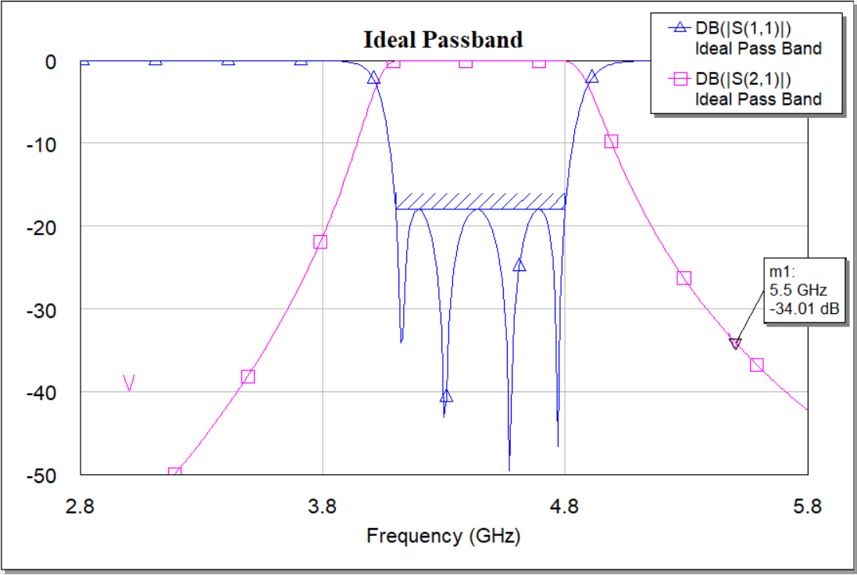
STEP 1: From Low-pass to ideal band-pass filter, with lumped elements
GRAPH
The return loss concerning requirements is clearly respected. It is instead a bit surprising that at 5.5 GHz the rejection does not go down until the requested value.
This behaviour is indeed unexpected considering that the theoretical order of the filter is approximated to 4 but the values are just a bit higher than 3.
Regardless of the reason why the behaviour is not ideal, a possible solution consists of increasing the order of the filter to 5.

Slide 11
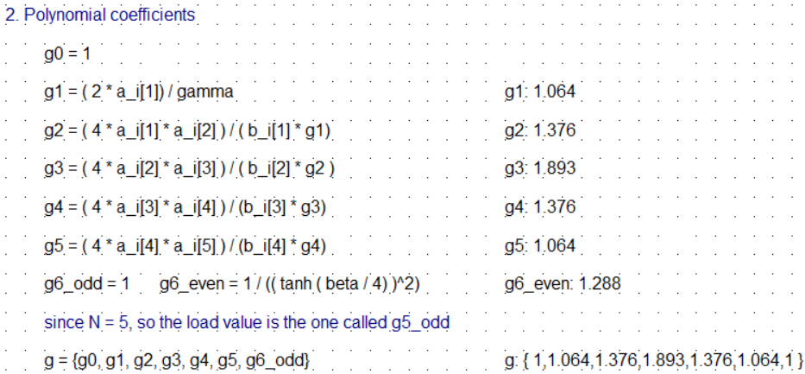
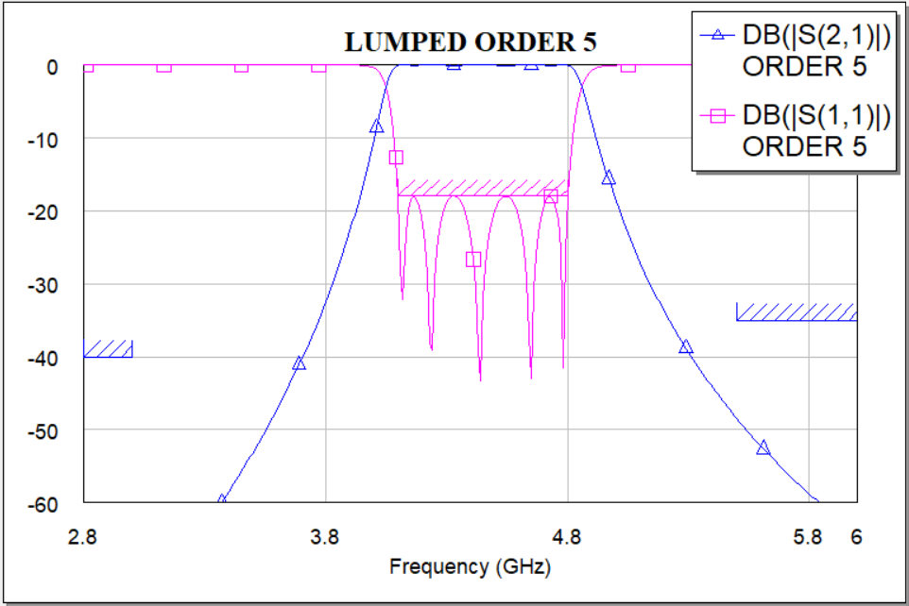
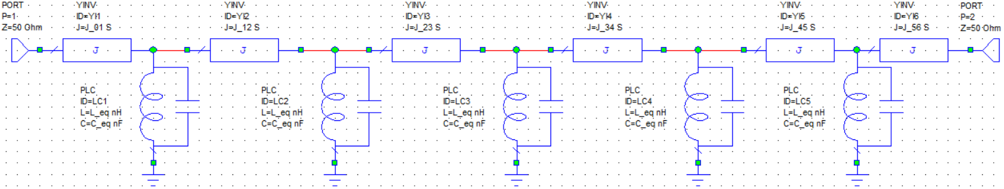
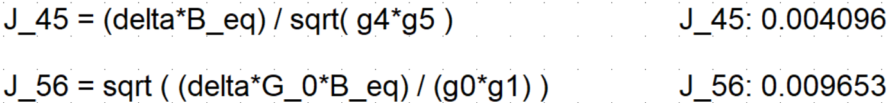
STEP 1: From Low-pass to ideal band-pass filter, with lumped elements
INCREAMENT OF THE ORDER

Slide 12
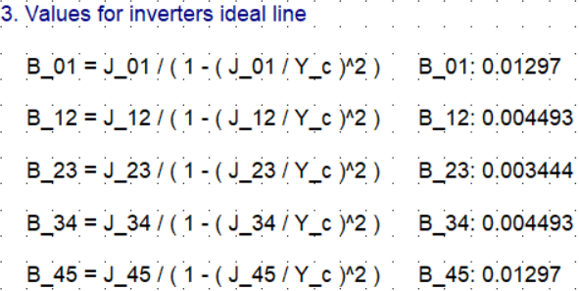
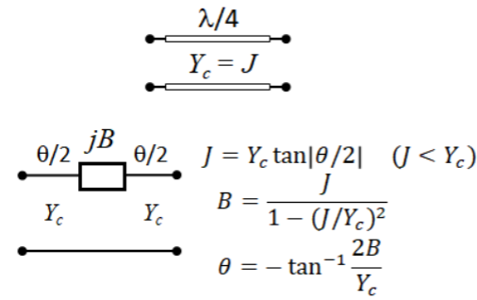
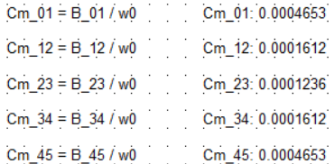
STEP 2: Ideal transmission lines
IDEAL INVERTERS SUSCEPTANCES
Considering the equivalent represantion of an inverter in terms of ideal transmission lines, every inverter will be modelled as a capacitor. The value of the respective capacitance is derived starting with the evaluation of the inverter equivalent susceptance.
$C_{mutual}=\frac{B}{ω_{0}}$

Slide 13
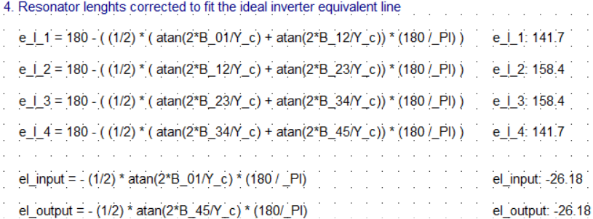
STEP 2: Ideal transmission lines
CAPACITANCES, ELECTRICAL LENGHTS
However, the electrical lenghts of the transmission lines working as resonators must be corrected in order to leave space for the capacitors.
Since for every resonator there are two inverters, the length is 180° minus the respective values of θ (look at the previous slide)

Slide 14
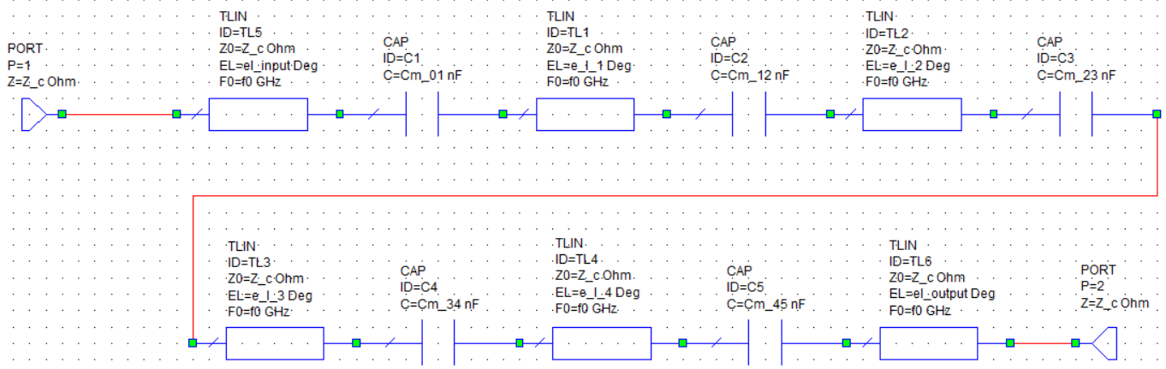
STEP 2: Ideal transmission lines
SCHEMATIC

Slide 15
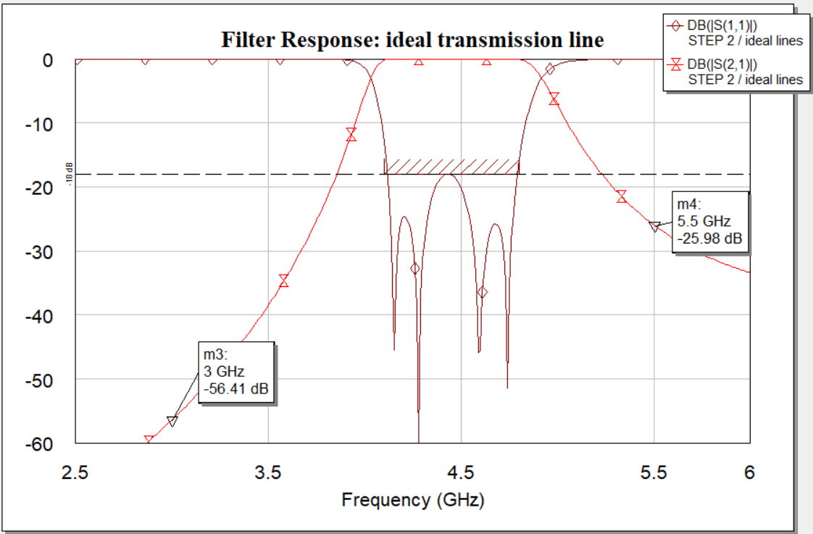
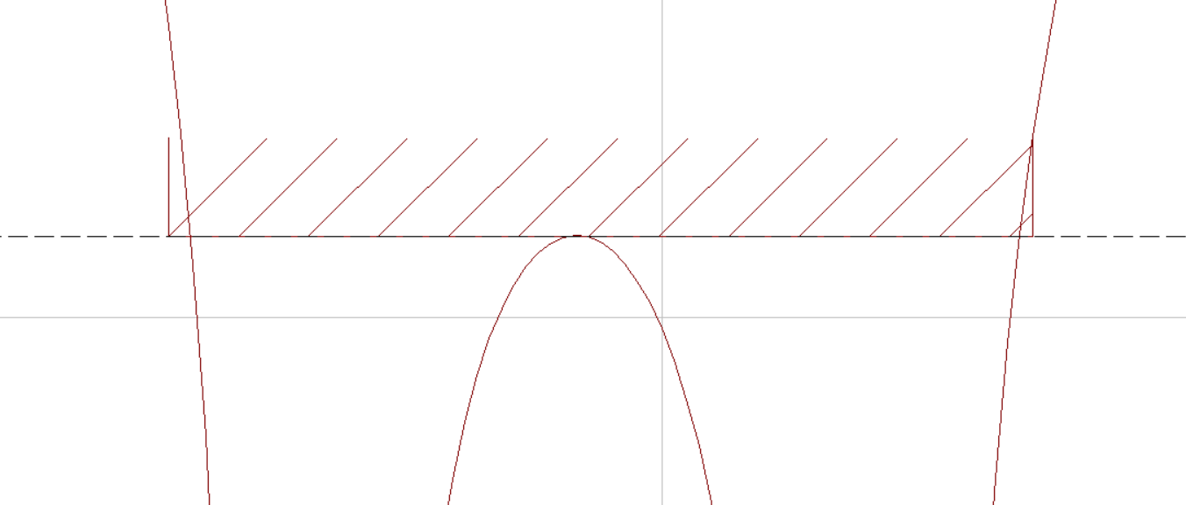
STEP 2: Ideal transmission lines
GRAPH
Not only the attenuation at 5.5 GHz is too small (we need an higher rejection out-of-band), but also the response in the band is not acceptable.
We have to remember that capacitors are modelling the behaviour of the gaps, but they are not perfectly interchangeable.

Slide 16
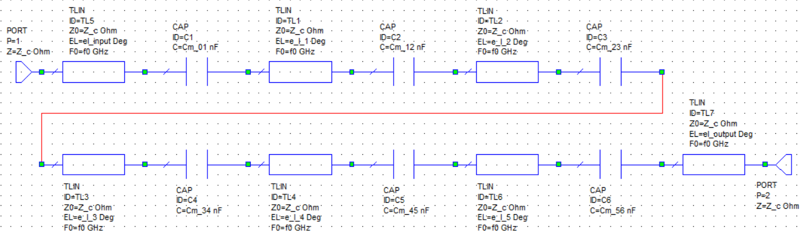
STEP 2: Ideal transmission lines
INCREAMENT OF THE ORDER
Here we see the schematic derived changing N to 5.

Slide 17
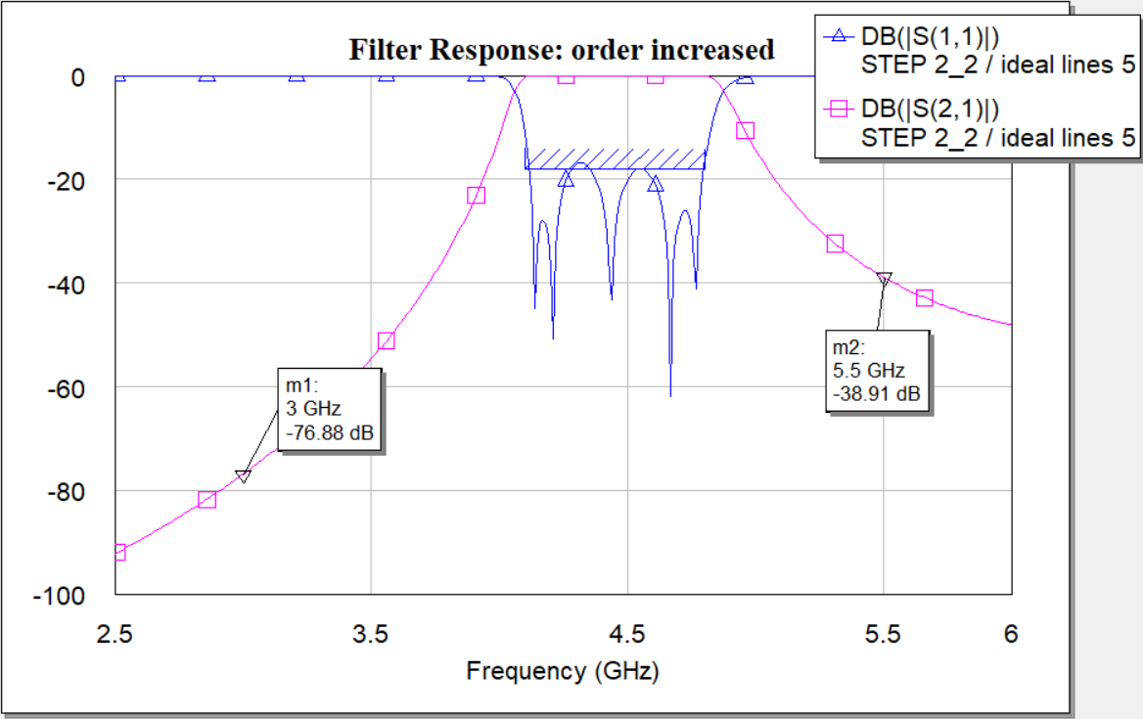
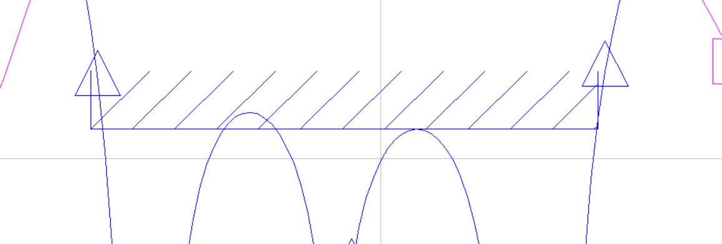
STEP 2: Ideal transmission lines
GRAPH (N=5)
The attenuation at 5.5GHz is now sufficient to respect the requirement. However, the situation in the band is still not acceptable.
Since tuning Z_c is not enough to compensate the imperfection of this realization, the optimizer inherit in AWR must be run over some parameters.

Slide 18
STEP 2: Ideal transmission lines
OPTIMIZATION
The optimizer has been set to modify automatically the capacitances and the electrical lenghts of the resonators.
The first approach take as starting point the circuital design found at the STEP 2 for N=4.
In this first optimizer call, only the band requirment has been selected as the goal of the optimization. It’s evident that the requirment at 5.5 GHz is not respected.
The second graph reported is what the optimizer returns when both the requirements are asked to be respected. It’s clear that we cannot accept the result, since none of the requirements is respected.
In the end, the optimization has been set to run over the design parameters of the filter with N = 5.

Slide 19
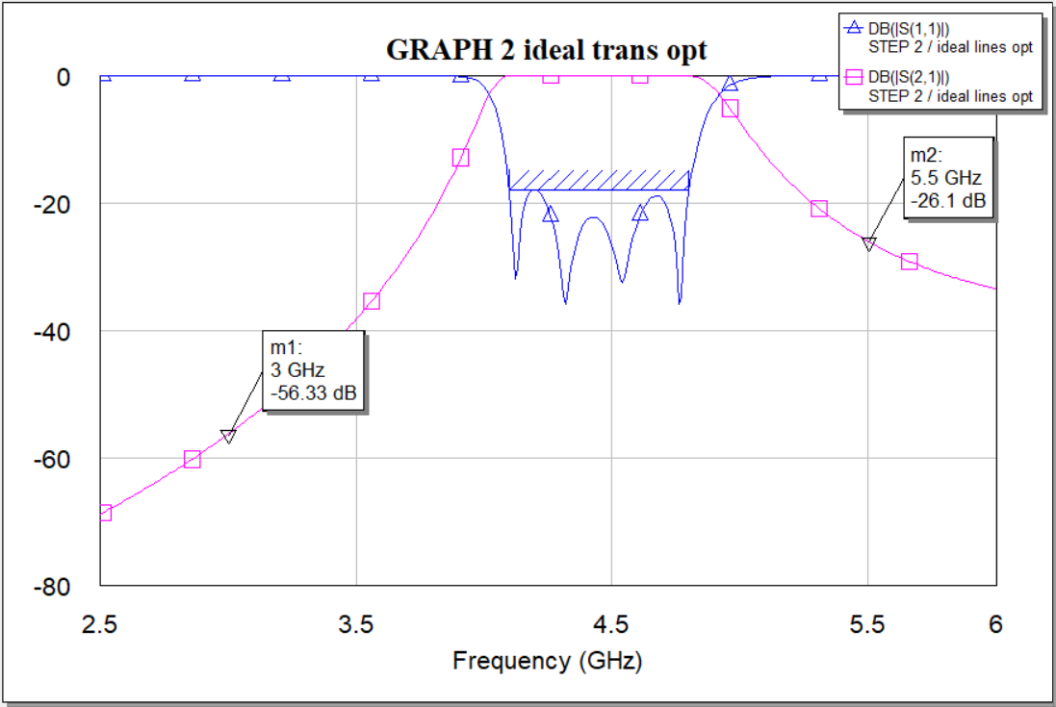
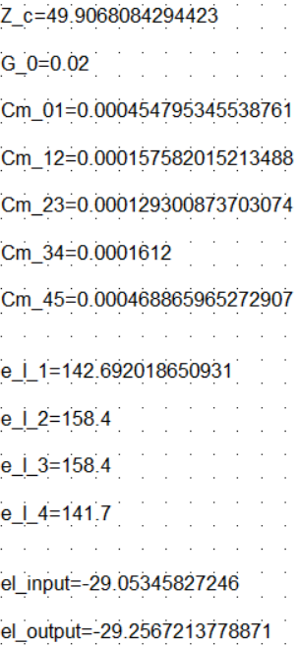
STEP 2: Ideal transmission lines
OPTIMIZATION: N=4, band requirement selected

Slide 20
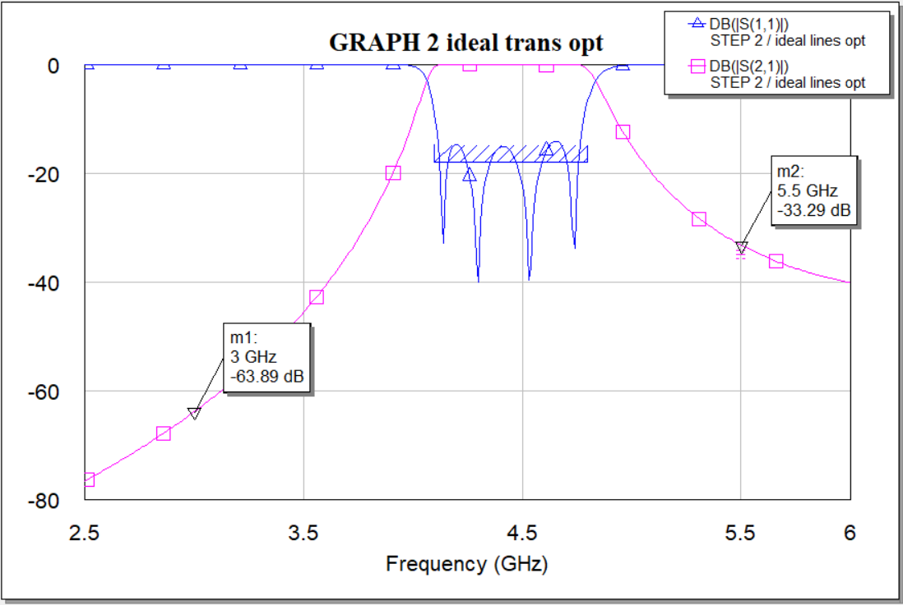
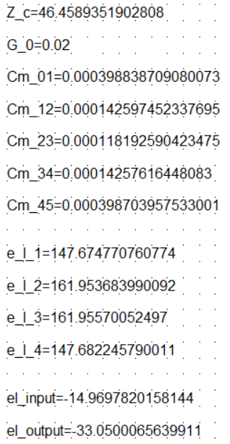
STEP 2: Ideal transmission lines
OPTIMIZATION: N=4, band requirement selected + attentuation at 5.5

Slide 21
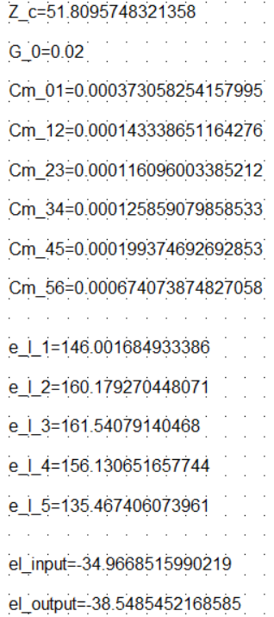
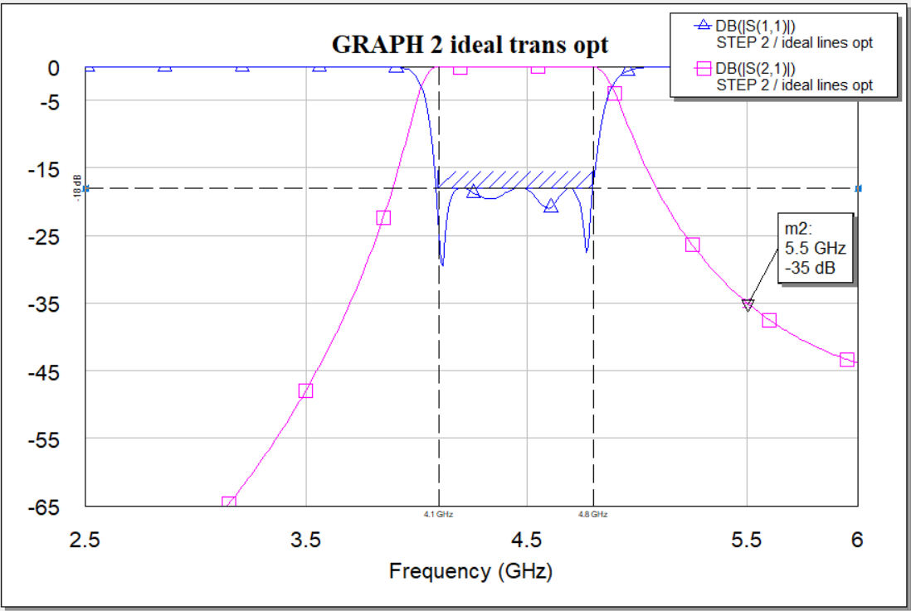
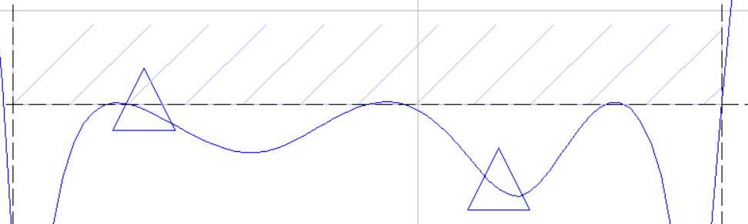
STEP 2: Ideal transmission lines
OPTIMIZATION: N=5, band requirement selected
What the optimizer returns is a set of the values that it has the permit to modify such that the plot is the closest to the requirements. As we can see, once we zoom a lot, the reflection plot seems overpass the rejection in-band requirement, but since this is not the final step of the design we could accept it.

Slide 22
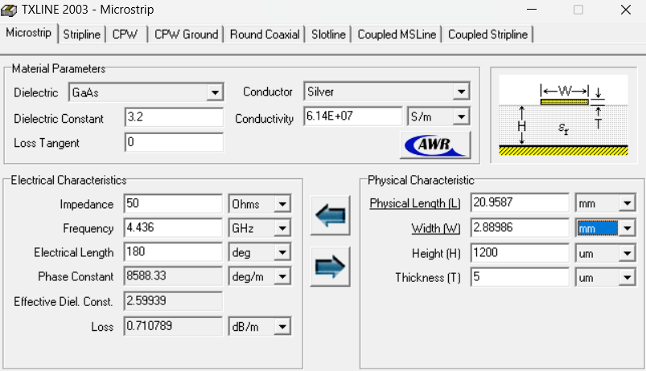
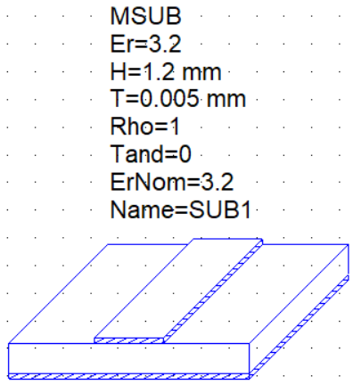
STEP 3: Microstrip Substrate
First of all, exploiting the TxLine tool in the AWR script panel, the physical lenght and width of the transmission lines are derived. We have assumed an intrinsic impedance of 50 Ohm, a central frequency of 4.436 GHz and an electrical lenght of 180 deg. Secondly, with the element “MSUB” it is possible to define a substrate for the microstrip.

Slide 23
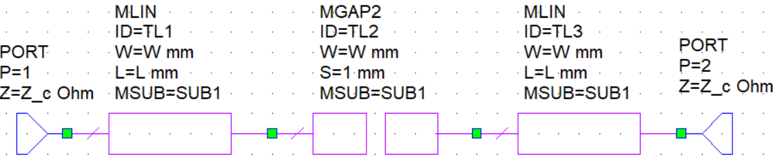
STEP 3: Microstrip Substrate
The aim of the next step is to find the exact value of spacing characterizing the gap blocks.
This evaluation must be done for each gap. The ports are set at the beginning of the lines, but we must shift them to coincide with the gap itself. This can be possible once we extracted the schematic.

Slide 24
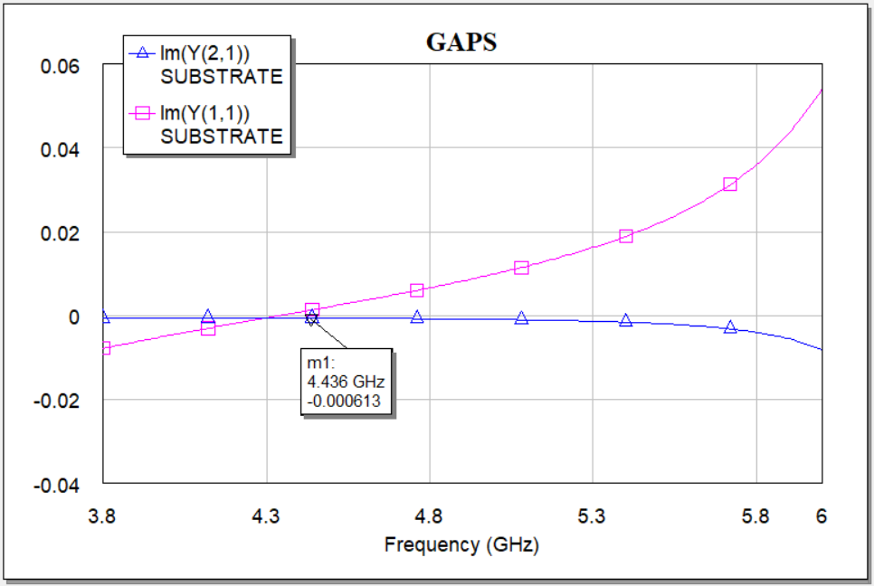
STEP 3: Microstrip Substrate
In the plot we can see the values of specific admittance parameters, obtained by means of the AXIEM electromagentic simulation.
However, Cm_ij has been caclulated as B_ij / w0.
Therefore, we just have to search for the value of s such that the absolute value of the imaginary part of Y_21 is equal to the Bij.
$C_{m}=−\frac{ℑ\left(Y_{21}\right)}{ω_{0}}$
$c_{p}=\frac{ℑ\left(Y_{11}+Y_{21}\right)}{ω_{0}}$

Slide 25
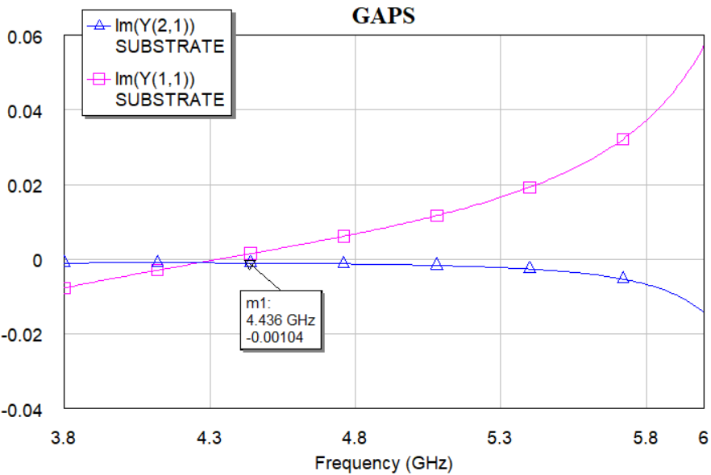
STEP 3: Microstrip Substrate
For the parameters fixed in the schematic we obtain a value of Y_21, that is too small. We need to change the tunable parameters in order to find at least the higher value of suscepptance, 0.0129, referred to the first and last gaps (i.e. the inverters).
We must keep in mind that we can change the spacing and the width of the transmission line. If we decrease the spacing until 0.5 mm we obtain the plot aside. Obviously, it’s not enough.

Slide 26
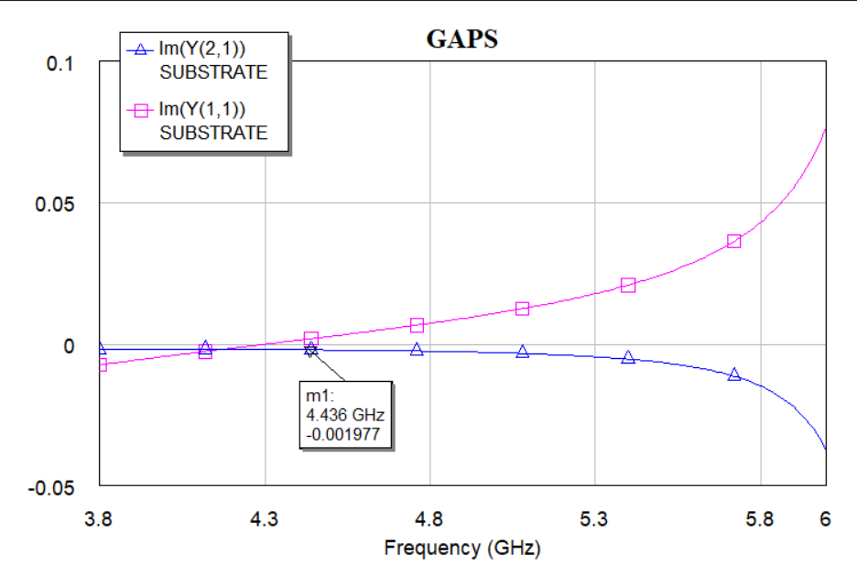
STEP 3: Microstrip Substrate
The searched value is practically 10 times bigger than what we obtain with a s of 0.02 mm.
We can try to improve the coupling increasing the width of the lines.
However in this case also the impendance will change and the suscepptance values as well.

Slide 27
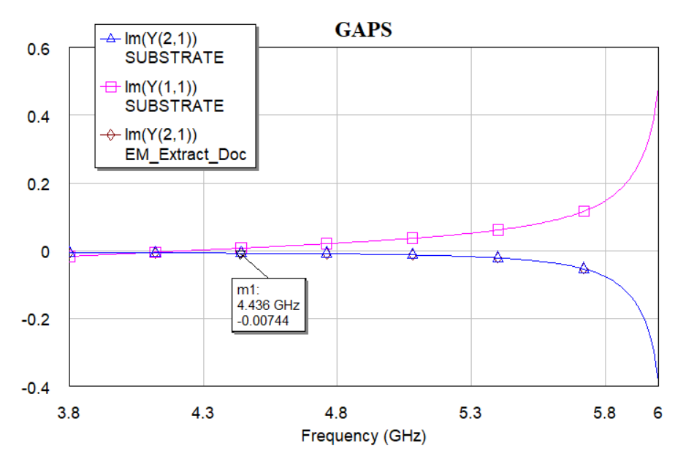
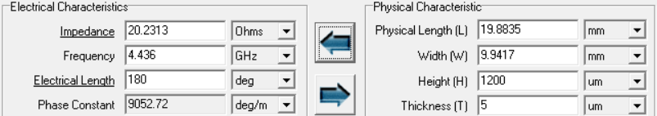
STEP 3: Microstrip Substrate
This is a very extreme situation, where it has been considered the highest value of width achievable before going over its higher bound, that is the half of the wavelength corresponding to the central frequency.
We must rely on different devices to model the gaps and increase the coupling.

Slide 28
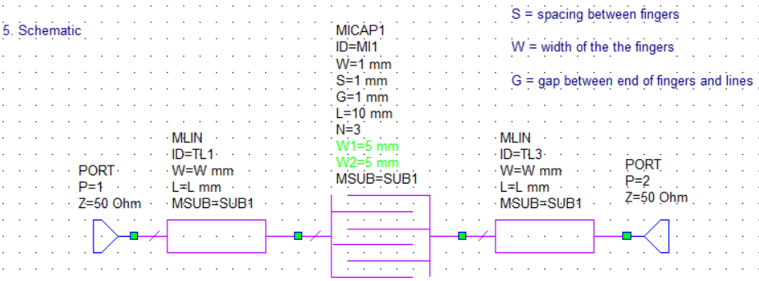
STEP 3: Interdigital Capacitors (MICAP1)
Initial schematic ( the parameters are set automatically to default values)
TxLine:
Z_c = 34.4242
L = 20.4662
W = 5 mm

Slide 29
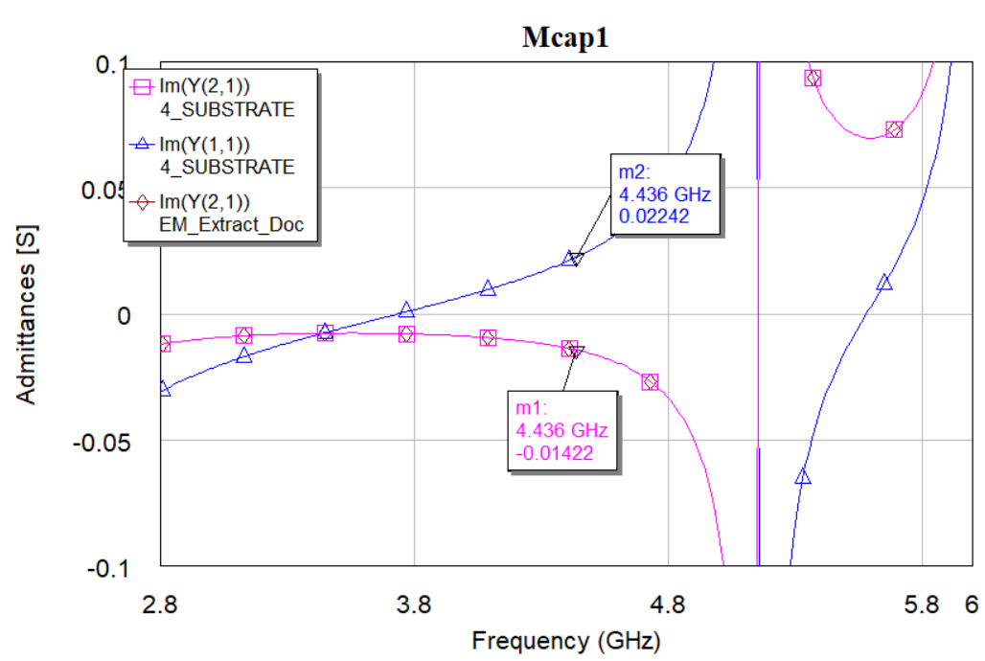
STEP 3: Interdigital Capacitors (MICAP1)
Gap 01/45
B_01 = 0,01422
W = 0,32 mm
S = 0,2 mm
G = 1 mm
L = 1,878 mm
N = 10
Cp_15 = (0,02242-0,01422)/27,87= 0,2942 pF

Slide 30
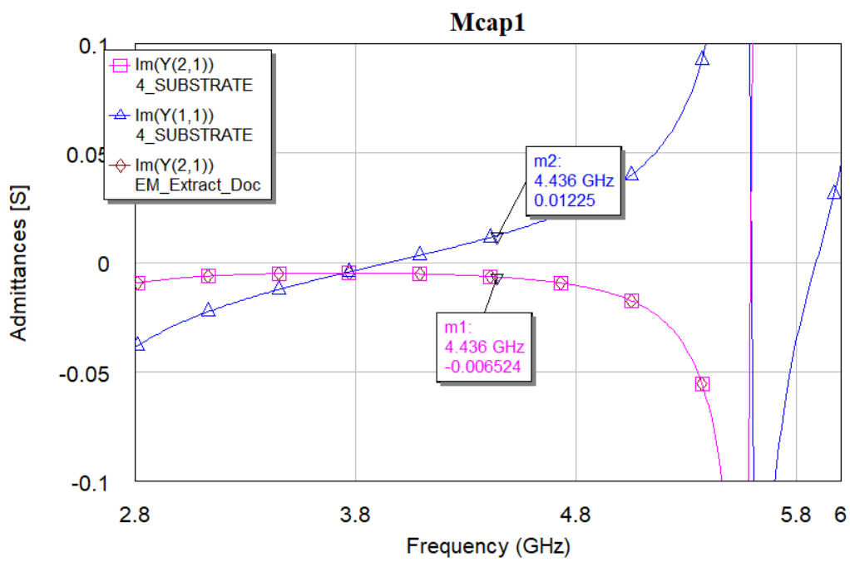
STEP 3: Interdigital Capacitors (MICAP1)
Gap 12/34
B_12 = 0,006525
W = 0,32 mm
S = 0,2 mm
G = 0,8 mm
L = 1,163 mm
N = 10
Cp_23 = (0,01225-0,006524)/27,87= 0,2054 pF

Slide 31
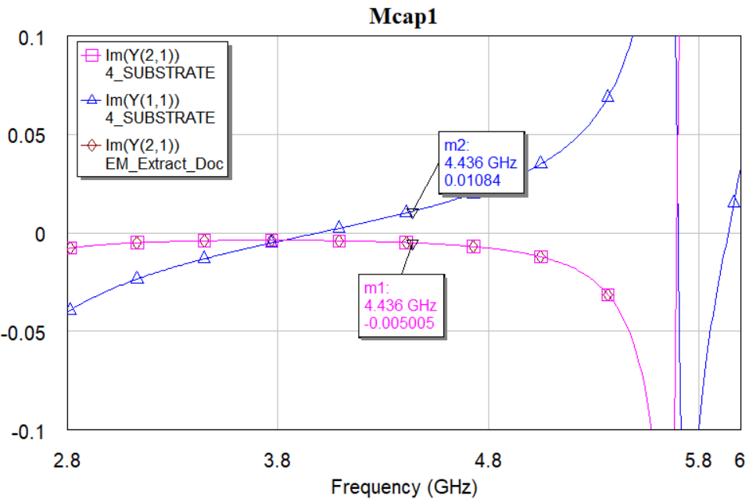
STEP 3: Interdigital Capacitors (MICAP1)
Gap 23/34
B_23 = 0,005003
W = 0,32 mm
S = 0,2 mm
G = 1 mm
L = 0,878 mm
N = 10
Cp_3 = (0,01084-0,005005)/27,87= 0,2093 pF

Slide 32
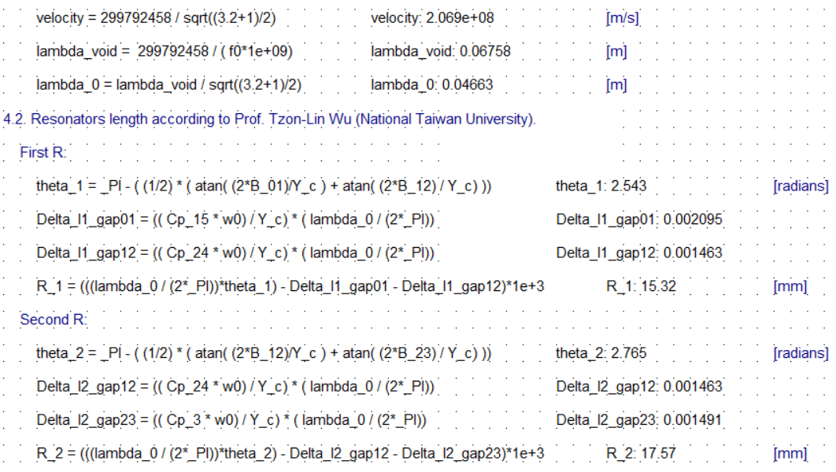
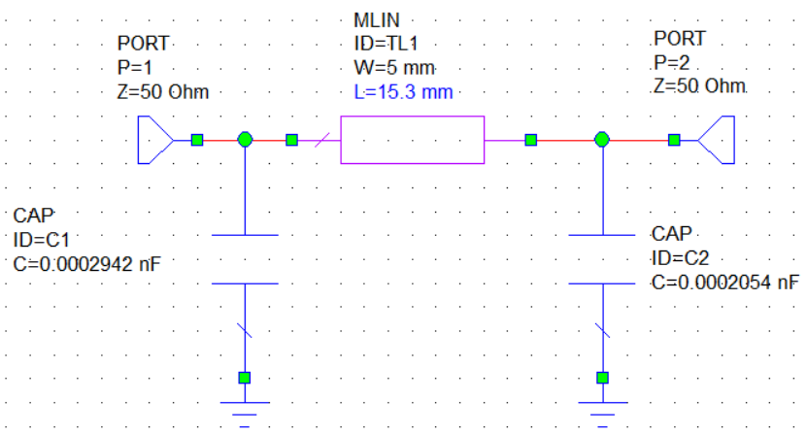
STEP 3: Electromagnetic Simulation
Resonators lenghts
Alternatively we could use the equivalent circuital schematic to tune manually the lenght of each resonator.
The image above represents the tuning done for the first resonator. The values are practically the same (L = 15.32)

Slide 33
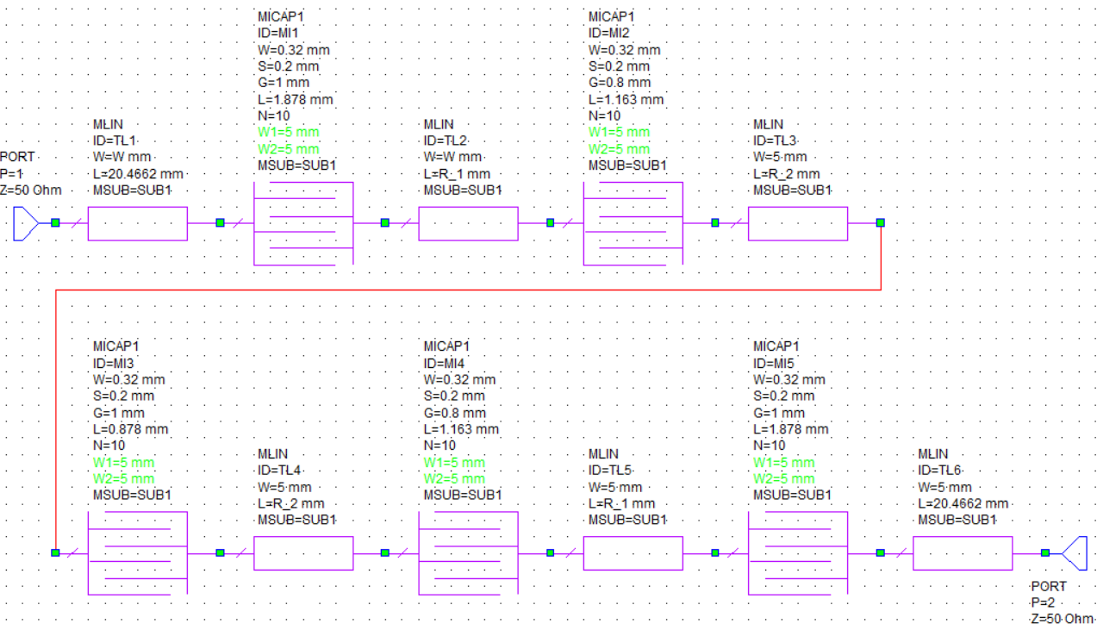
STEP 3: Electromagnetic Simulation
Final Schematic

Slide 34
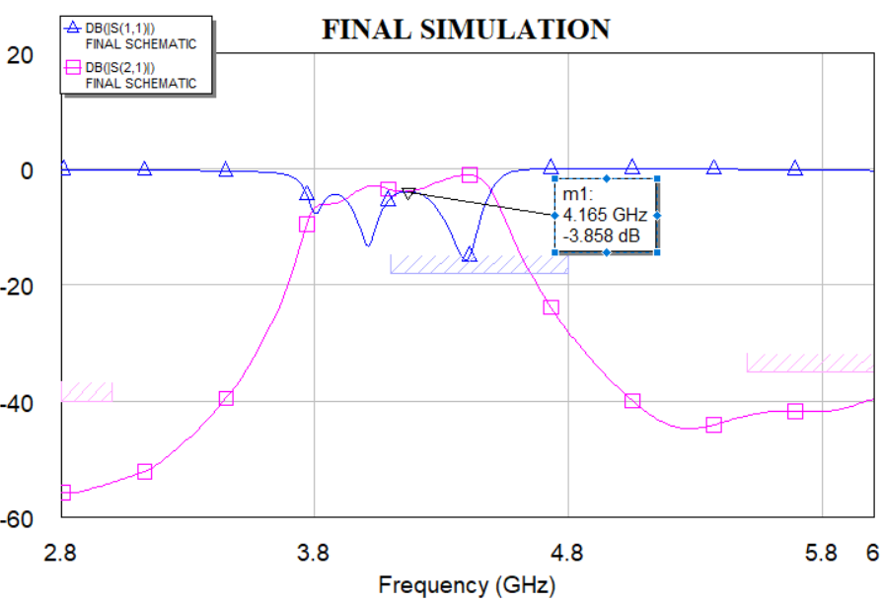
STEP 3: Electromagnetic Simulation
Graph NOT optimized
The filter does not return a satusfying plot. The bandwidth requirement is not respectes, the return loss 15 dB higher. The only requirements respected so far are the ones concerning the out-of-band attenuation.
Unfortunately the transmission seem depressed, even if the “tand” parameter has been kept nill.

Slide 35
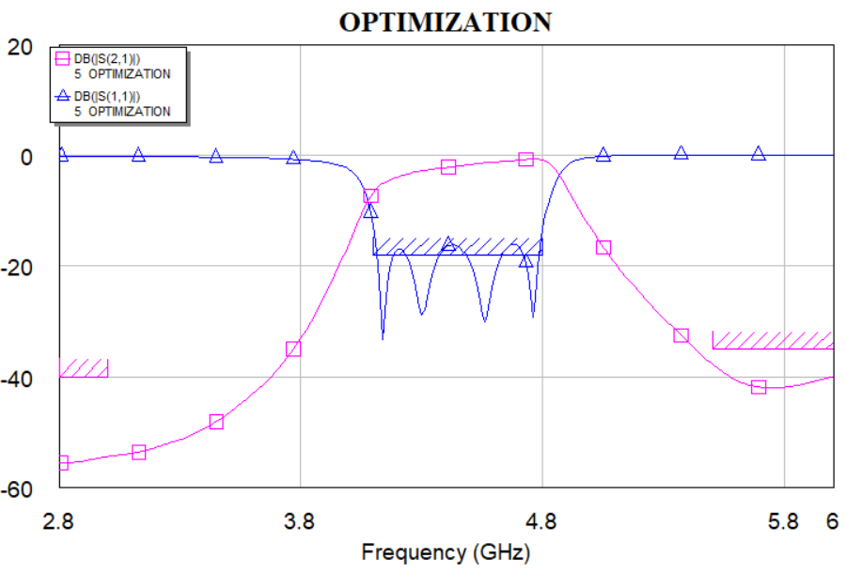
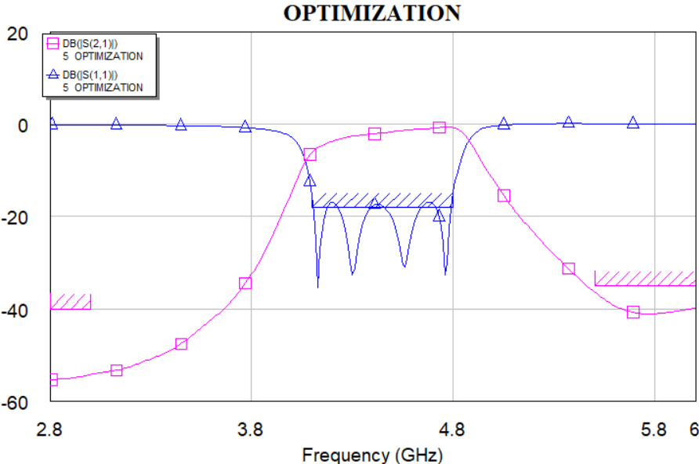
STEP 3: Electromagnetic Simulation
Graph optimized
After 500 iterations of KAPU
After 2000 iterations of KAPU

Slide 36
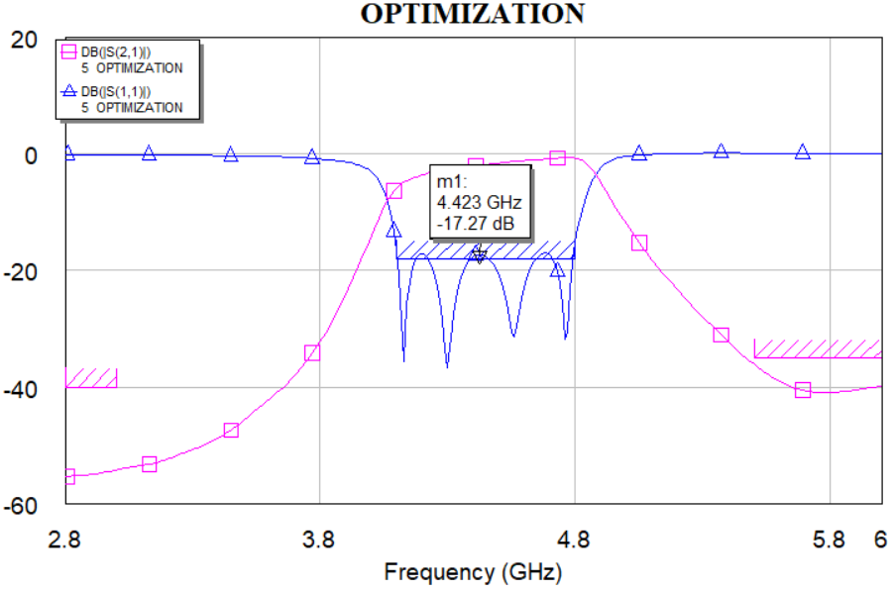
STEP 3: Electromagnetic Simulation
Graph optimized, 4000 iterations of KAPU (optimization method)
L_input = 17,2485698571257
G_01 = 0,784506724299976
L_01 = 2,25363416886992
G_12 = 0.0900375650661024
L_12 = 0.707911247254743
G_23 = 0.762661136716216
L_23 = 0.871293941791847
R_1 = 14.8239922803857
R_2 = 16.665417817108
L_output = 16.770330565146

Slide 37
As we can see in the last picture, the plot obtained is not perfect. Regardless of the high number of iterations, the absolute value of the first parameter of scattering do not respect the return loss requirement. There is a difference of 0.73 dB. In terms of power it means that there is a fraction of the “signal” coming back that is 10^{0.073} = 1.176 times higher than requested.
Is it tolerable? It depends on how much precisely our filter must perform according to the specific application for which it will be employed.
A possible solution would be the re-design of the filter for an order of 5.

